Slide 1
2022-2023 SUSSI Operating Budget
Chase Slenker,
SGA VP of Finance
Kay Stottlemyer,
SUSSI Staff Accountant

Slide 2
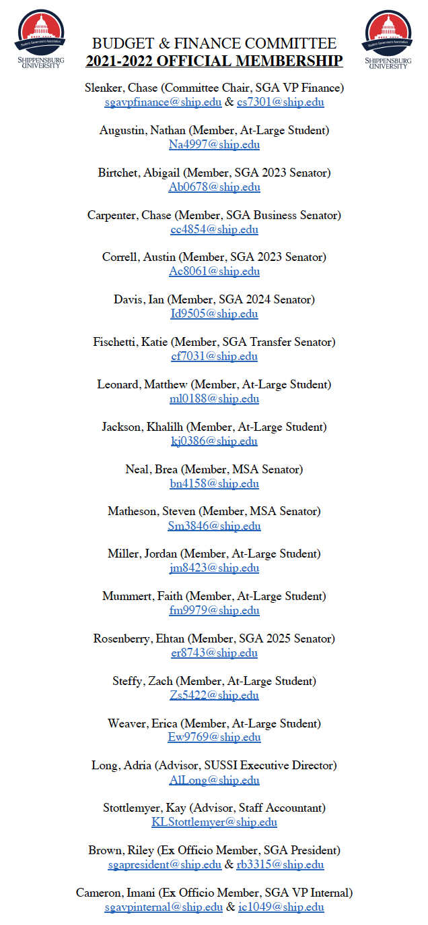
WHAT IS SGA BUDGET & FINANCE?

Slide 3
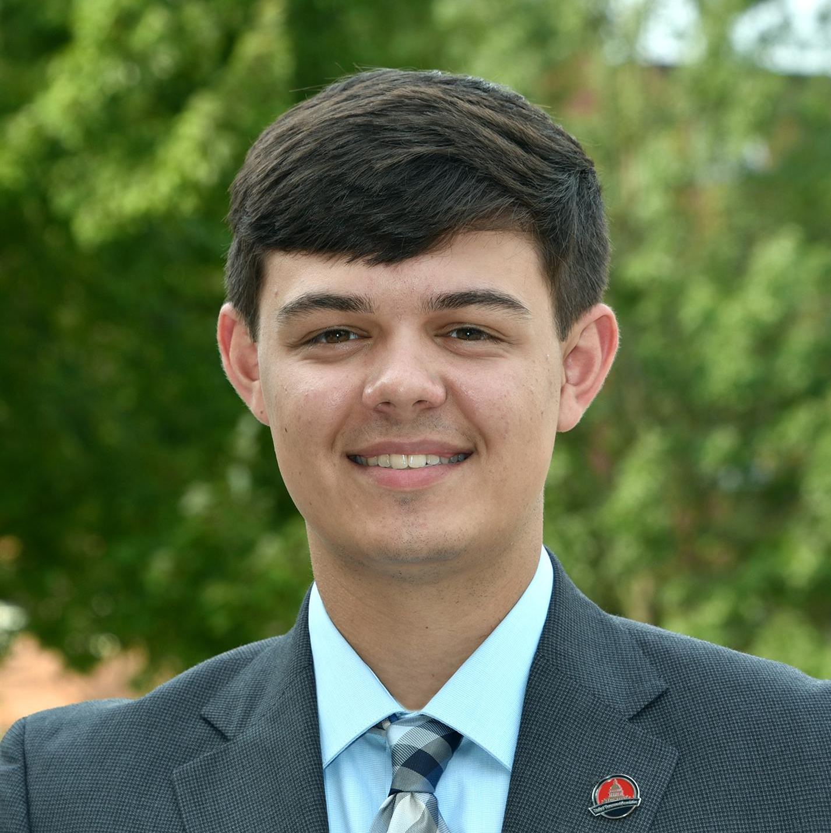
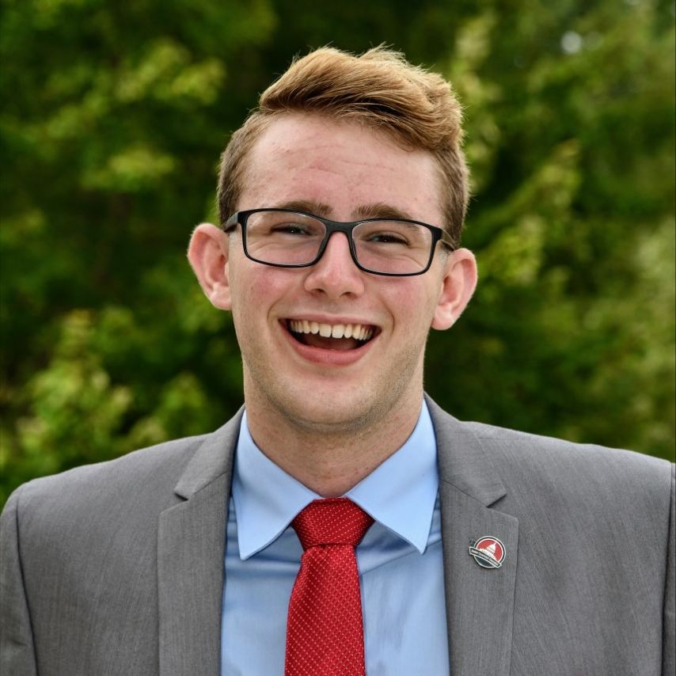
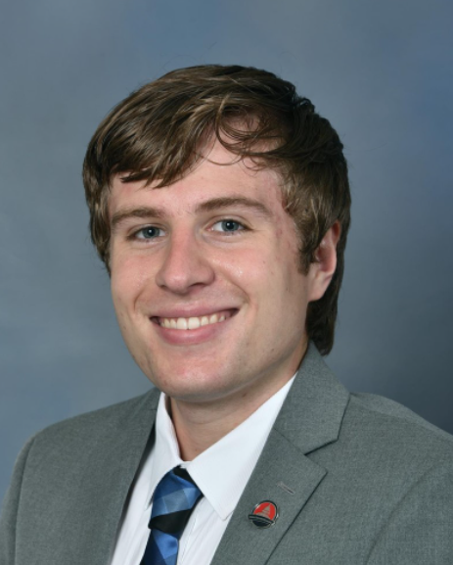
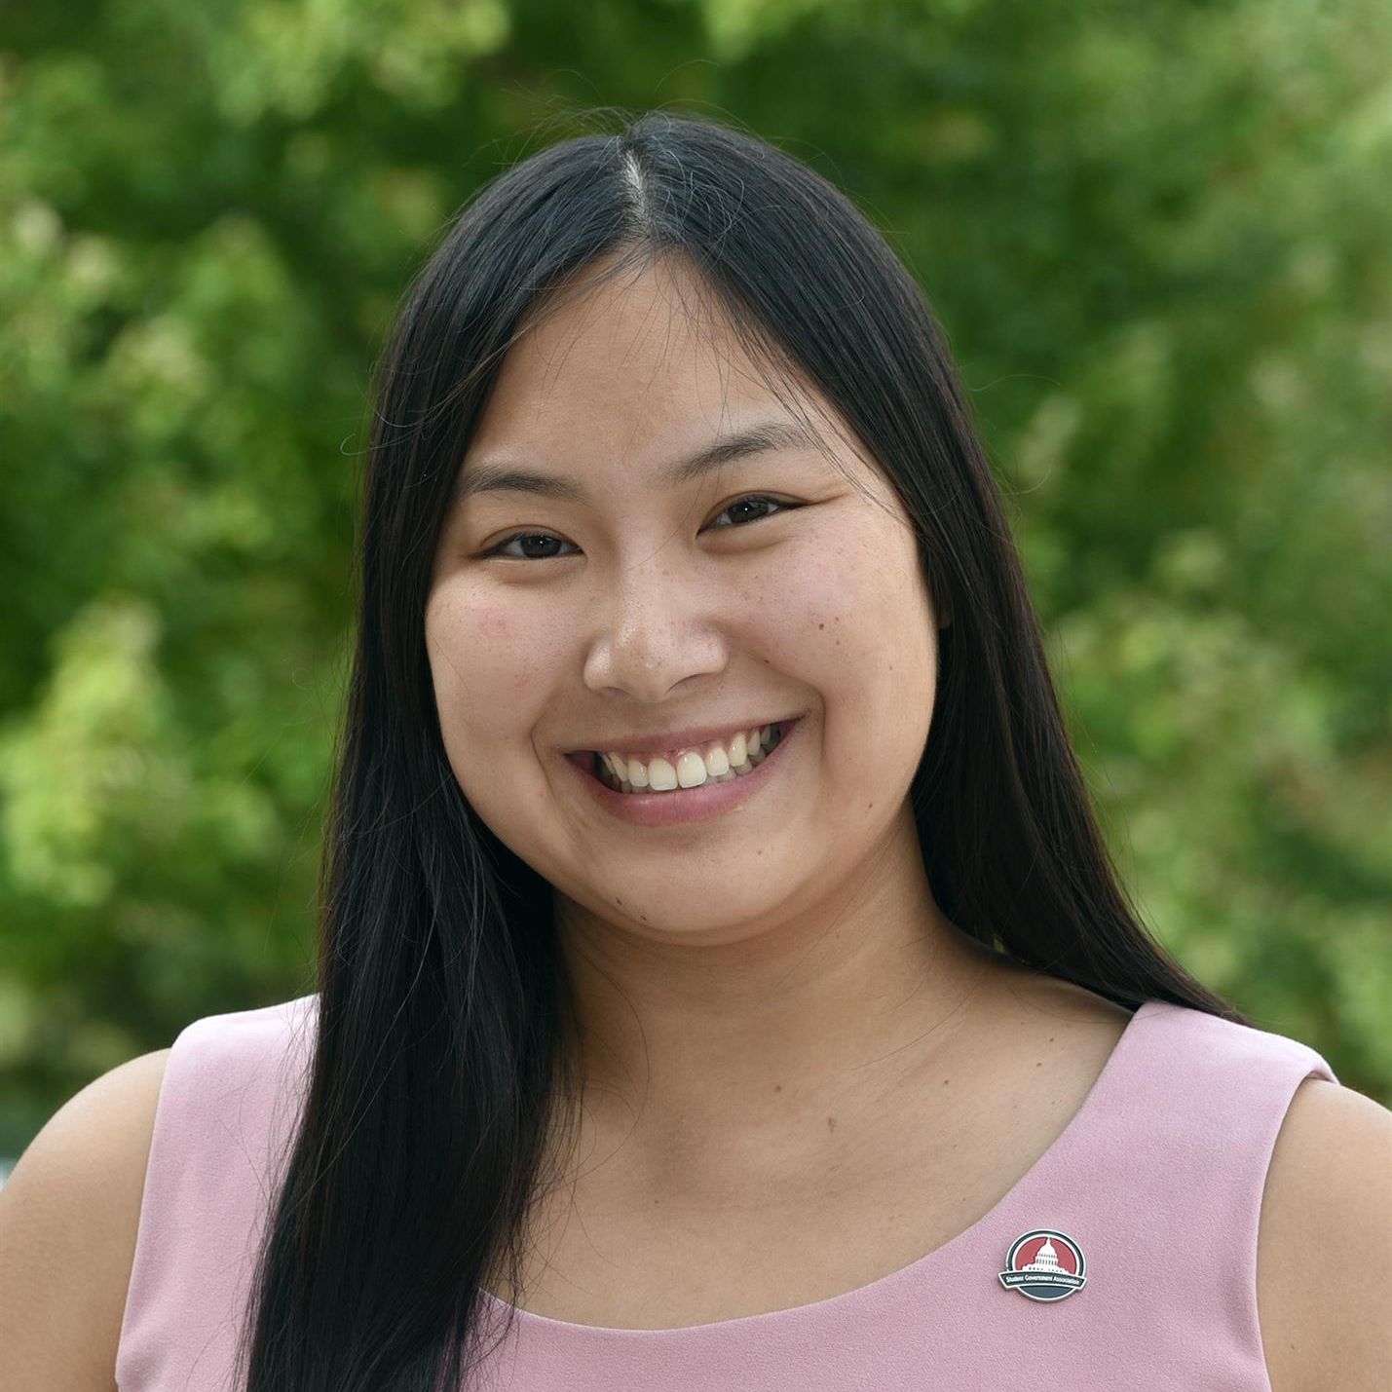
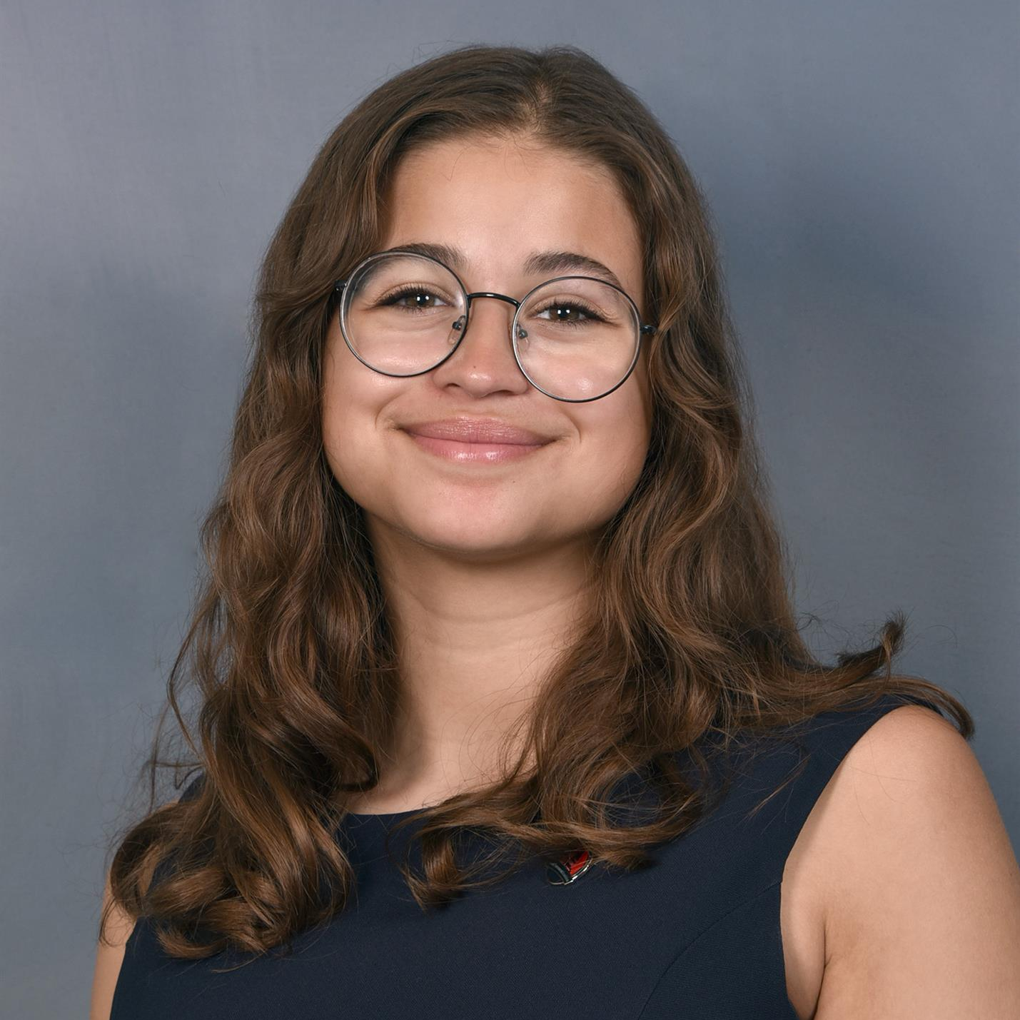
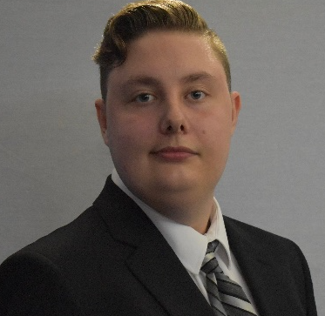
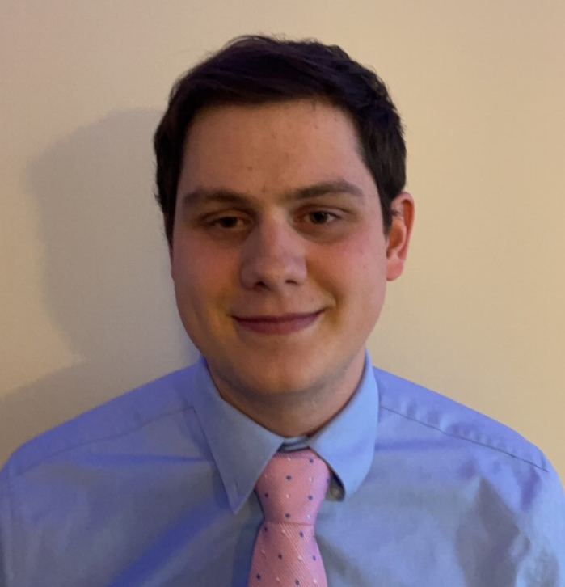
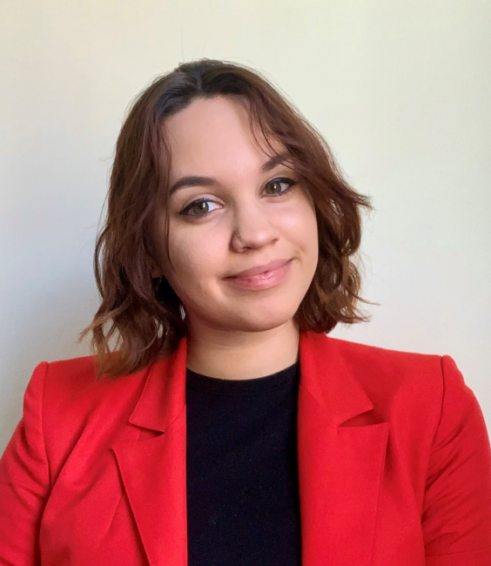
2022-2023 SGA BUDGET & FINANCE
Faith Mummert
Nathan Augustin
Austin Correll
Chase Slenker
Erica Weaver
Andrew Hare
Katie Fischetti
Abigail Birtchet
Khalilh Jackson
Jordan Miller
Steven Matheson
Zach Steffy
Kennedy Holt
Ian Davis
Matthew Leonard
Brea Neal
Christina Pinto
Ethan Rosenberry

Slide 4
22-23 Budget Considerations
Support GROWTH and REBUILDING of Student Groups
Prioritize allocations that would benefit the greatest number of students
Consider previous cuts to student groups and groups that have faced no decreases
Prioritize the day-to-day operations of student groups over additional experiences, such as conferences and post-season tournaments
Work towards a sustainable operating budget to mitigate large-scale cuts if SUSSI were to completely deplete reserves (Reducing annual deficit spending)

Slide 5
Deficit Spending & Reserve Usage
Long-Term Challenges, Mitigation Decisions, and Potential Solutions

Slide 6
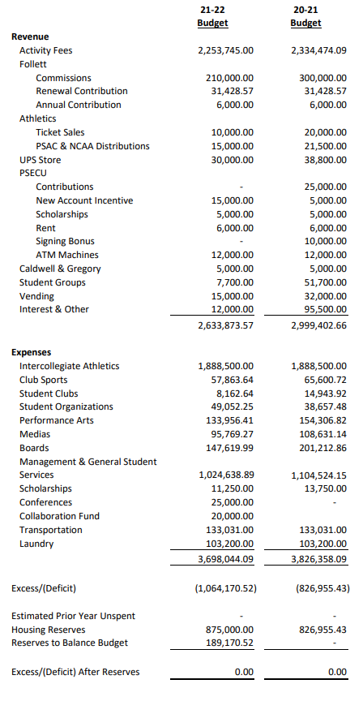
Current Deficit Spending Trend
Multi-Year trend of 800,000-1,100,000 per year of deficit spending
(Spending more money than we bring in)

Slide 7
Current Trend Maintained
Current Reserve Projections After 20-21 Year End $6.2 Million
Amount Owed to University for Housing -$1.7 Million
Amount on Loan to SU Athletics (10 Years) -$2.2 Million
Reserves Left for Operating Budgets (2021) $2.3 Million
2021-2022 Fiscal Year Budget (CURRENT) -$1.1 Million
Reserves By Fall 2022 $1.2 Million
Continuation of Current Budget (22-23) -$1.1 Million
Reserves By Fall 2023 $100,000

Slide 8
Reserve-Usage Concern
By this fiscal year (2022-2023 Fiscal Year), SUSSI will have roughly million dollars in reserves and will be unable to provide current funding levels at or beyond this point.
If the deficit is not reduced NOW, SUSSI will need to balance its budget leading to at least a 30% cut in total expenditures; most of which will come out of athletics which represents 50% of total spending and 70% of direct student activity spending
*This includes current spending and enrollment trends, two years of athletics loan repayment and, adjustments for loss of interest income

Slide 9
21-22 Past Potential Solutions
Massive Jump In Enrollment (2,022 Full Time Students Needed to Cover Deficit)
Increase the Student Activity Fee
Expand the Student Activity Fee to online classes (non-online program) and/or to Graduate students
Continue to reduce services and activities available to students through budget cuts
(Ex. intercollegiate athletics, laundry contract, transportation expenses)

Slide 10
WE WANT TO MITIGATE IMPACTS ON THE STUDENT EXPERIENCE
YOU CAN ONLY CUT SO MUCH
WE NEED REVENUE INCREASES & EXPENSE CUTS

Slide 11
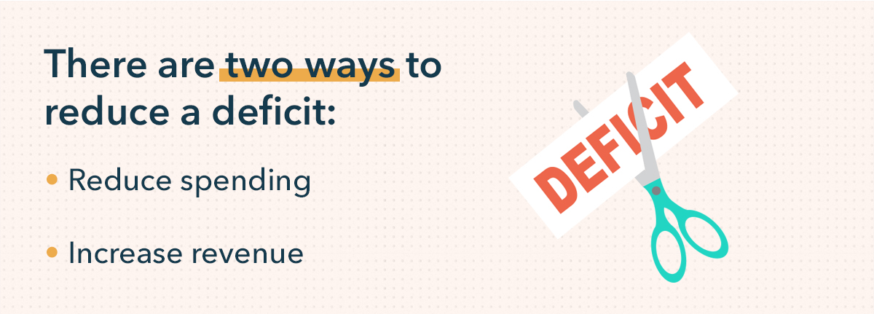
SGA Budget & Finance Plan of Action
Implement new fee schedule to generate more revenue while still considering future enrollment decreases
Expand activity fee to Graduate Students
Expand activity fee to online course offerings
Decrease high-expense areas and areas facing no prior cuts

Slide 12
Why A Fee Increase?
NECESSITY NOT CHOICE

Slide 13
Current Fee Schedule – No Change since 2016
Undergraduate Students
$272 Full Time Student Equivalent (12+ Credits)
$23/credit (1-11 Credits)
Graduate Students
$0/credit (Last Charged in 2016-2017)
Undergraduate Online Classes (Not Online Only Programs)
$0/credit (Never Charged)
16-17 → 21-22 FTE Enrollment is down 21%
16-17→ 21-22 Activity Fee Revenue is down 23%

Slide 14
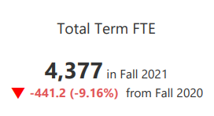
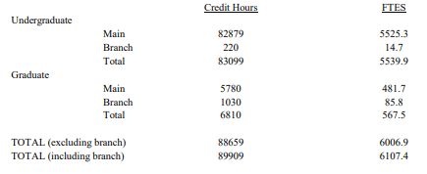
Declining Enrollment
$632,128 in decreased revenue last year since the last fee change in 2016.
NOW – Fall 2021
(4,377 FTE)
THEN – Fall 2016 (5,539 FTE)
(5,539 – 4,377)=1,162 FTE
1,162 FTE students x $272/semester x 2 semesters = $632,128

Slide 15
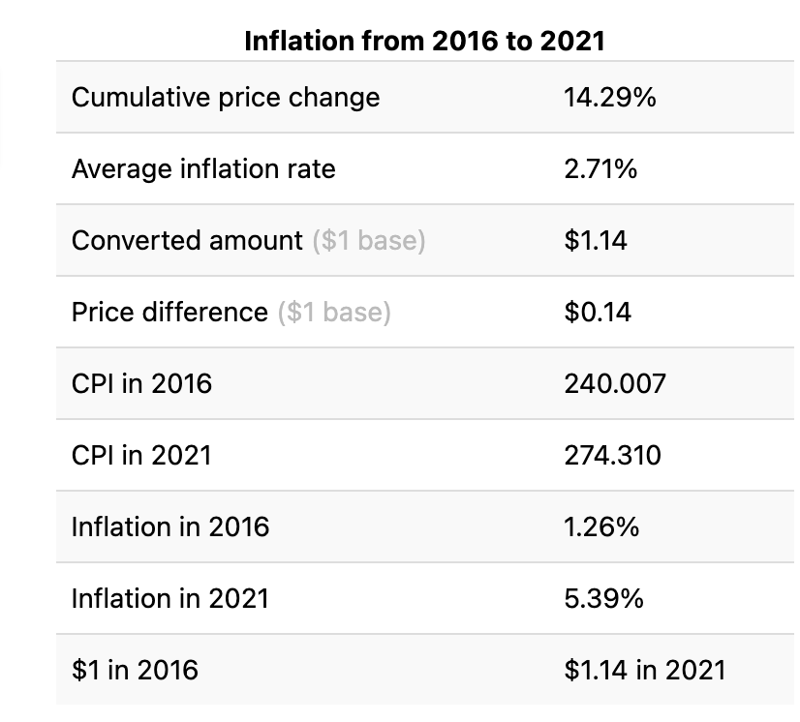
EFFECTS OF INFLATION
For the same services/supplies & equipment we are spending $454,145 more in 2021 than we would have in 2016.*
*
*[3,698,044-(3,698,044./1.14)]= $454,145 in inflation driven decreases in in expense value since last fee change (2016).

Slide 16
OPPOSITE EFFECT
$632,128 in lost revenue last year just from enrollment decreases since last fee change in 2016.
$(632,128)
$(454,145)
$(1,086,273)
For the same services/supplies & equipment we are spending $454,145 more in 2021 than we would have in 2016.
This does not factor in:
Loss of all Housing Revenue
Maintaining Laundry Contract for three-year period past loss of housing revenue
Low Interest on Reserves
THE TOTAL 1.1 MILLION DEFICIT CAN NOT ALL BE CUT IN EXPENSES

Slide 17
2012-2013 - $240 ($20/credit) Undergraduate + $14/credit Graduate
2013-2014 - $255 ($21/credit) Undergraduate + $15/credit Graduate
2014-2015 - $264 ($22/credit) Undergraduate + $16/credit Graduate
2015-2016 - $264 ($22/credit) Undergraduate + $16/credit Graduate
2016-2017 - $272 ($23/credit) Undergraduate + $16/credit Graduate
2017-2018 - $272 ($23/credit) Undergraduate
2018-2019 - $272 ($23/credit) Undergraduate
2019-2020 - $272 ($23/credit) Undergraduate
2020-2021 - $272 ($23/credit) Undergraduate
2021-2022 - $272 ($23/credit) Undergraduate
SUSSI FEE HISTORY

Slide 18
PASSHE COMPARISON
Name | Fee | Graduate
Indiana University | $ 630.00 | Yes
Mansfield University | $ 468.00 | Optional
Clarion University | $ 312.00 | Yes
California University | $ 300.00 | Yes
Cheyney University | $ 299.00 | No
LockHaven Unitersity | $ 294.00 | Yes
Shippensburg University | $ 272.00 | No
Edinboro University | $ 225.00 | No
Slippery Rock University | $ 203.00 | Yes
Kutztown University | $ 178.00 | No
West Chester University | $ 175.00 | Yes
East Stroudsburg University | $ 172.00 | No
Bloomsburg University | $ 169.00 | No
Millersville University | $ 161.00 | Unknown

Slide 19
2022-2023 Proposed Fee Schedule
Undergraduate Students
$295 Full Time Student Equivalent (12+ Credits)
$25/credit (1-11 Credits)
Generates $196,579.87 in ADDITIONAL Revenue with a 0% Change in Enrollment
Graduate Students
$180 Full Time Graduate Student Equivalent (9+ Credits)
$20/credit (1-9 Credits)
Generates $145,431.79 in NEW Revenue with a 0% Change in Enrollment
Undergraduate Online Classes (Not Online Only Programs)
$20/credit
Generates $19,373.93 in NEW Revenue with a 0% Change in Enrollment

Slide 20
2022-2023 Amended Fee Schedule
Undergraduate Students
$272 Full Time Student Equivalent (12+ Credits)
$23/credit (1-11 Credits)
Generates $0.00 in ADDITIONAL Revenue with a 0% Change in Enrollment
Graduate Students
$180 Full Time Graduate Student Equivalent (9+ Credits)
$20/credit (1-9 Credits)
Generates $145,431.79 in NEW Revenue with a 0% Change in Enrollment
Undergraduate Online Classes (Not Online Only Programs)
$20/credit
Generates $19,373.93 in NEW Revenue with a 0% Change in Enrollment

Slide 21
Budget Walk-Through
Presentation of 2022-2023 Fiscal Year Operating Budget

Slide 22
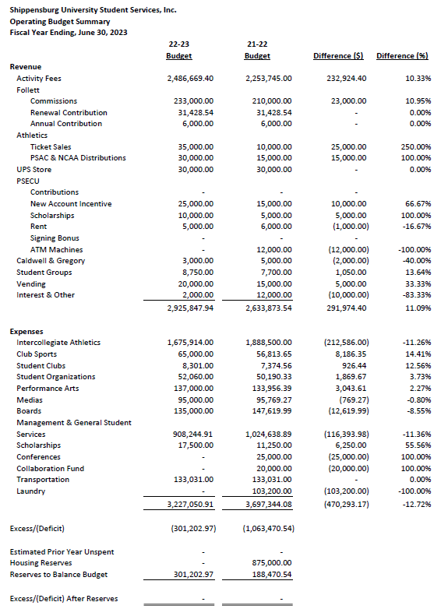
2022-2023 SUSSI Operating Budget

Slide 23
Revenue Increased $165,000.00
Expansion to graduate students will reduce excessive expense cuts
Student’s slight increase in activity fee preserves a similar student experience

Slide 24
22-23 Key Revenue Areas
0% change in student activity fee projections
New revenue projection method (Includes non-FTE)
Fee Schedule
Undergraduate Fee maintained
Expansion of fees to Graduate Students & Online classes
$20 a credit (1-9 credits)
NOT FULLY ONLINE PCDE PROGRAMS
Generates $164,805.72 worth of new revenue!

Slide 25
22-23 Key Revenue Areas
Large reduction in Interest income
A result of extremely low interest rates set by the Federal Reserve
A result of continued decreases in reserves (principal on investments)
Slight increase in Athletic Income
Returning to near pre COVID-19 ticket sales
New PSECU Contract
New UPS Contract

Slide 26
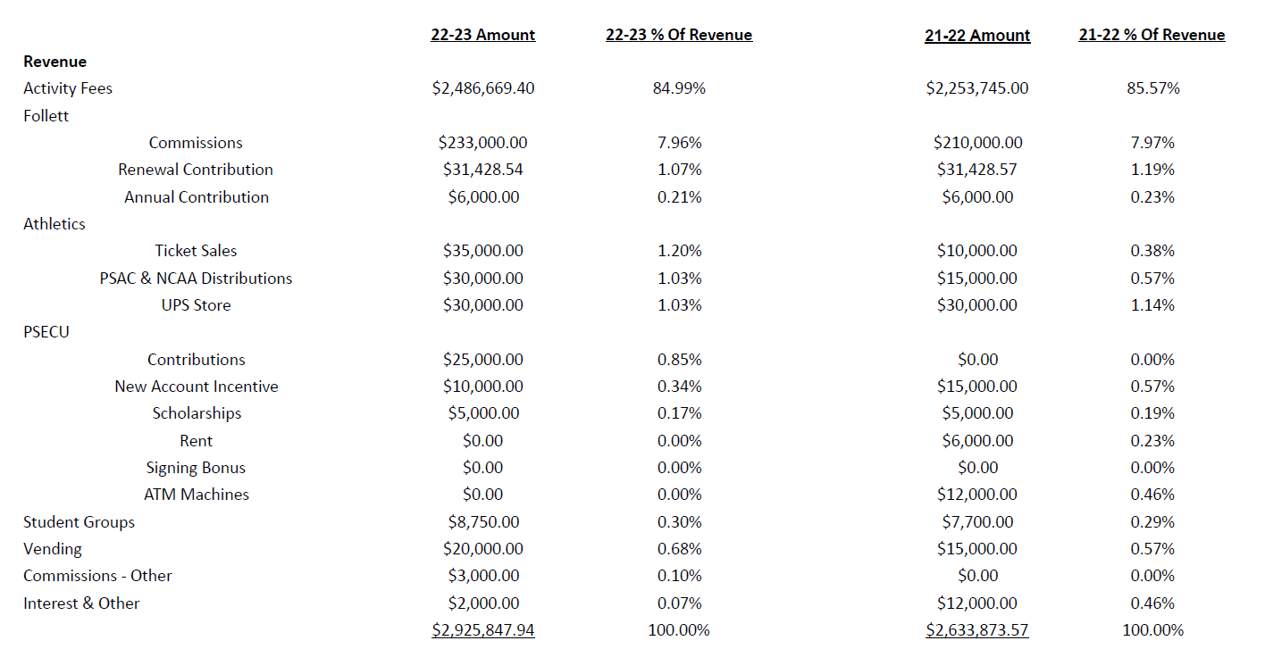
2022-2023 Revenue

Slide 27
Expenses Reduced $470,293.17
Still preserves a similar SU student experience
Equitably and efficiently distributes existing funds

Slide 28
22-23 Key Expense Areas
Intercollegiate Athletics – $1,675,914.00
Most coming from Facility and Transportation costs (new contract)
Recommendation to trim costs on equipment/uniforms, administration
Brings athletic budget in line with 2019-2022 budget cuts
Athletic Proposed Budget - $1,788,000.00

Slide 29
22-23 Key Expense Areas
Laundry Contract covered by the University
Shifting of student group funding – more Equitable & Thorough process
(approx. $2,000 net change)
Eliminated supplemental funds (Conference & Collaboration)
Large administrative cost reductions
Personnel changes/reductions
PAGE Center Coordinator
Fiscal Office staff retirement
CUB staff changes

Slide 30
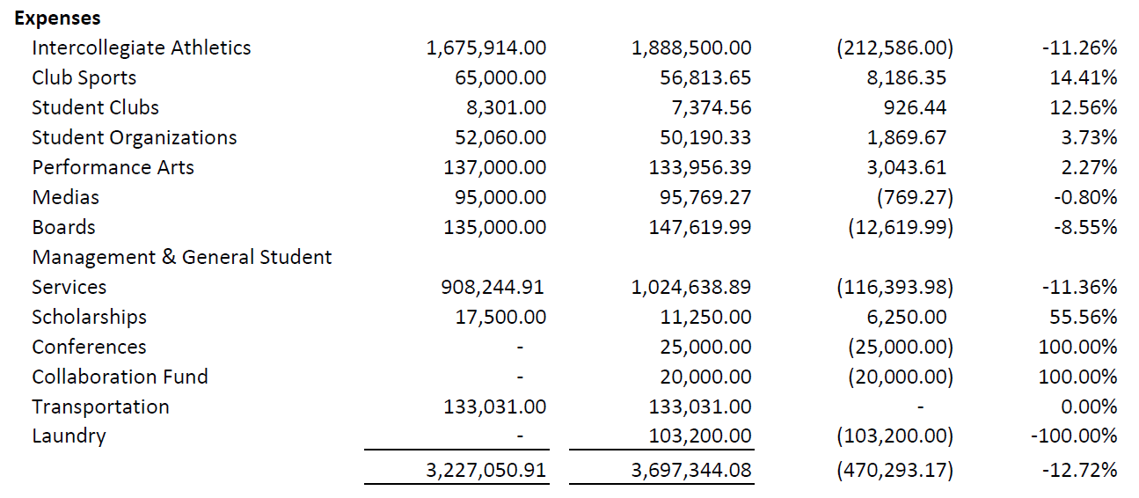
2022-2023 Expense

Slide 31
DEFICIT REDUCED $762,267.57
Will stretch existing reserves another 3 years!
Revenue increases and expense cuts reduce the structural deficit to $278,289.00

Slide 32
2023 Reserve Usage

Slide 33
22-23 Changes for Student Groups
Shared programming responsibility
Expanded budget training to better utilize financial resources
Leadership development & student group resources
Fundraising resources & training
Digital options (PayPal)
Cost efficiency planning

Slide 34
22-23 Changes for Graduate Students
Graduate students able to participate in all student life events
Graduate students can collect prizes, etc.
Continued participation of graduate students in NCAA athletics (per NCAA guidelines)
Increased advertisement for services (ex. Free tickets, Bus Service, etc.) to Graduate students

Slide 35
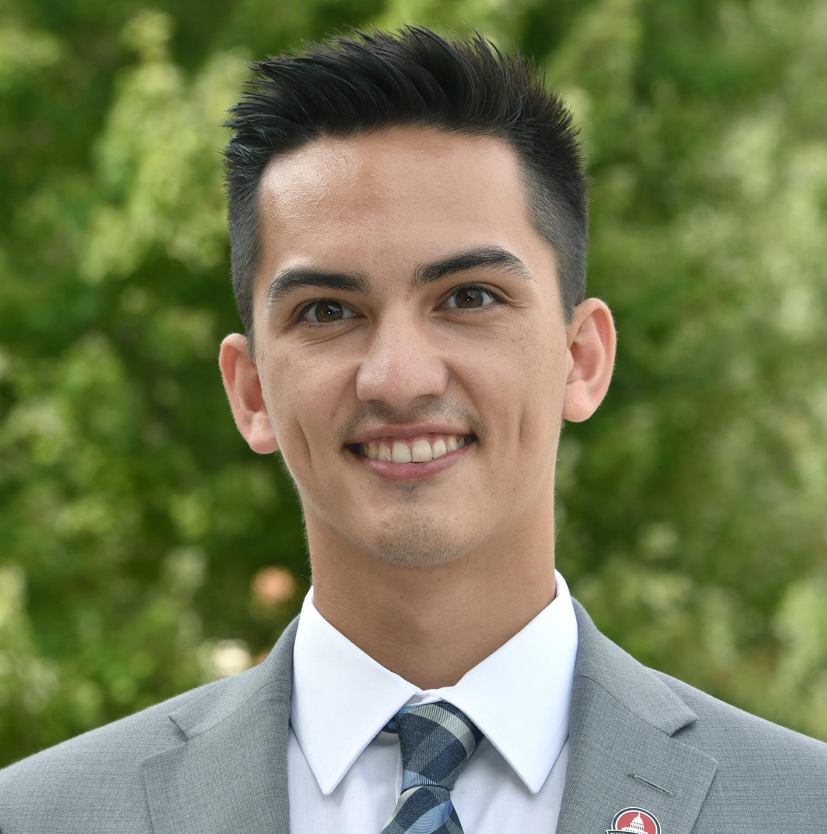
WE THANK YOU FOR CONSIDERING OUR BUDGET PROPOSAL!
Faith Mummert
Nathan Augustin
Austin Correll
Chase Slenker
Erica Weaver
Katie Fischetti
Abigail Birtchet
Khalilh Jackson
Jordan Miller
Steven Matheson
Zach Steffy
Ian Davis
Matthew Leonard
Brea Neal
Chase Carpenter
Ethan Rosenberry

Slide 36
Questions & Discussion

